Slide 1
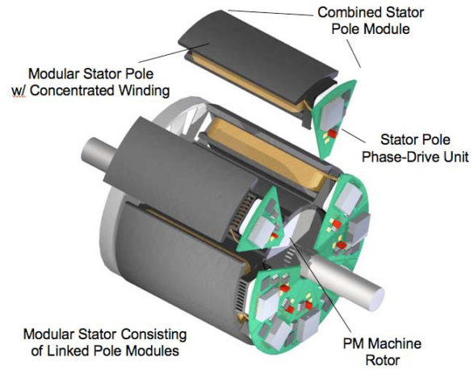
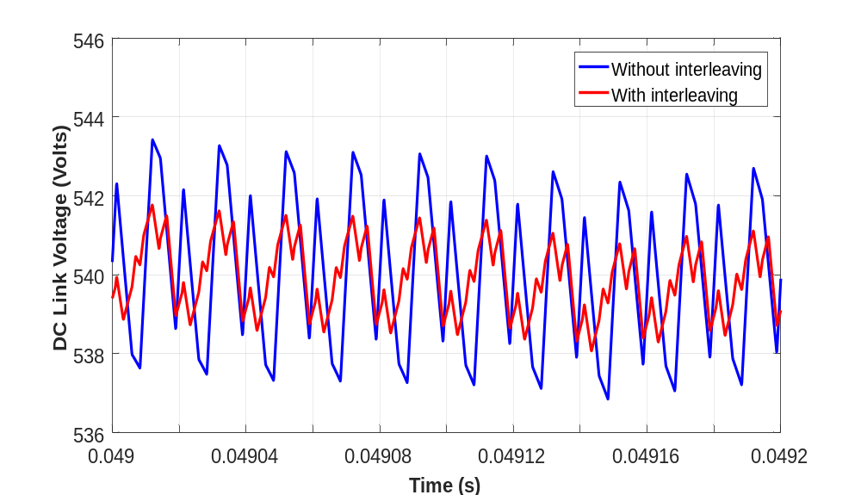
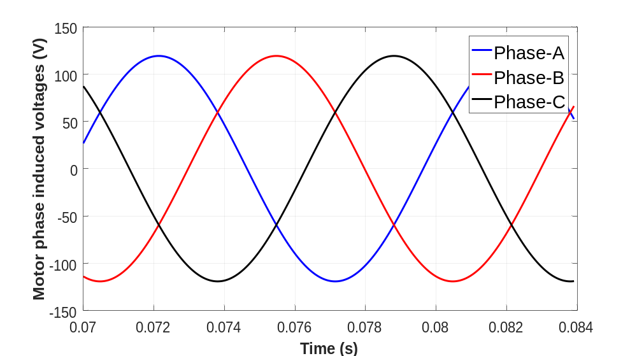
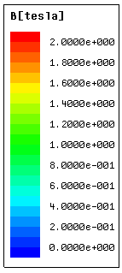
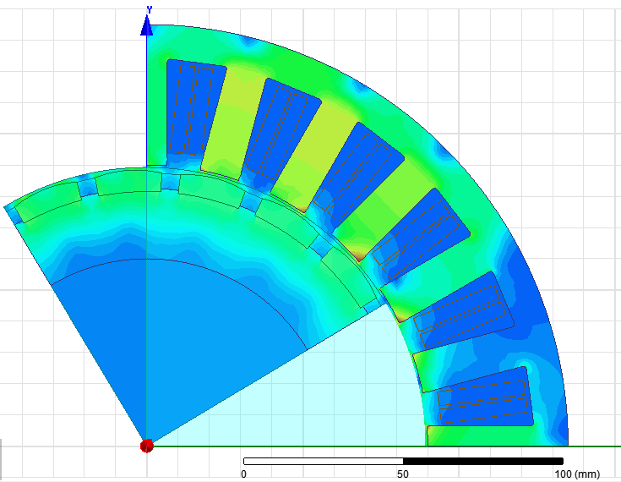
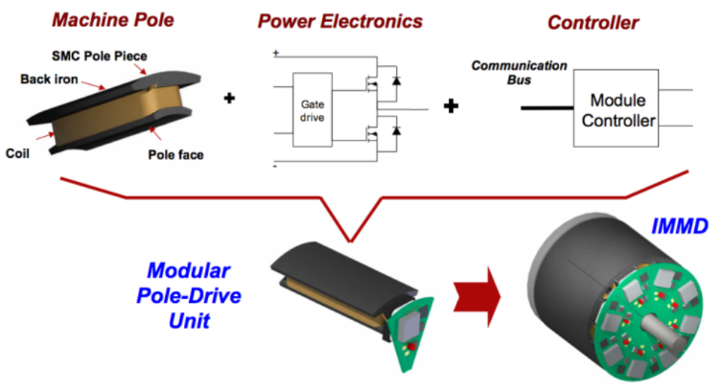
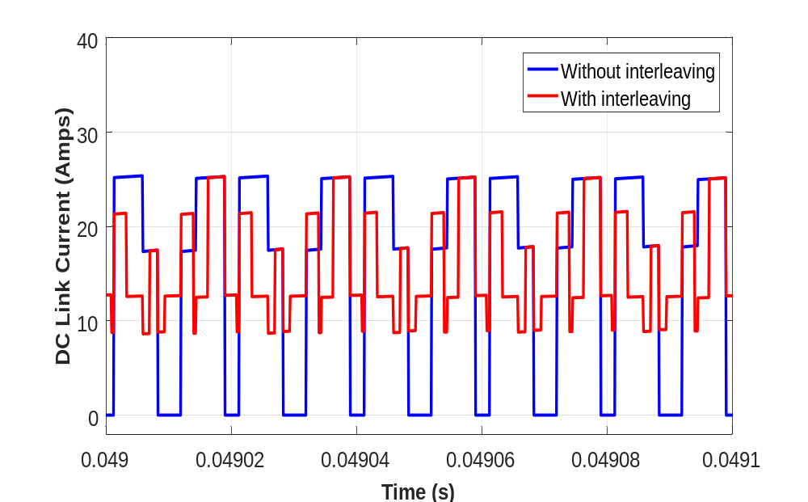
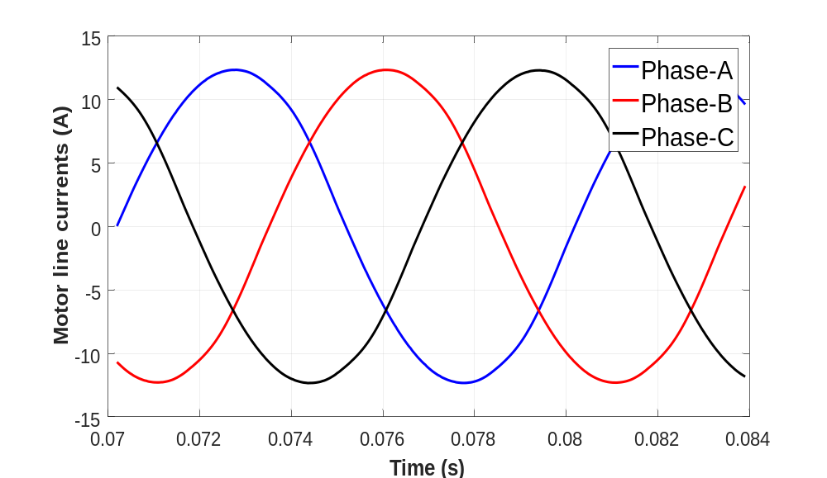
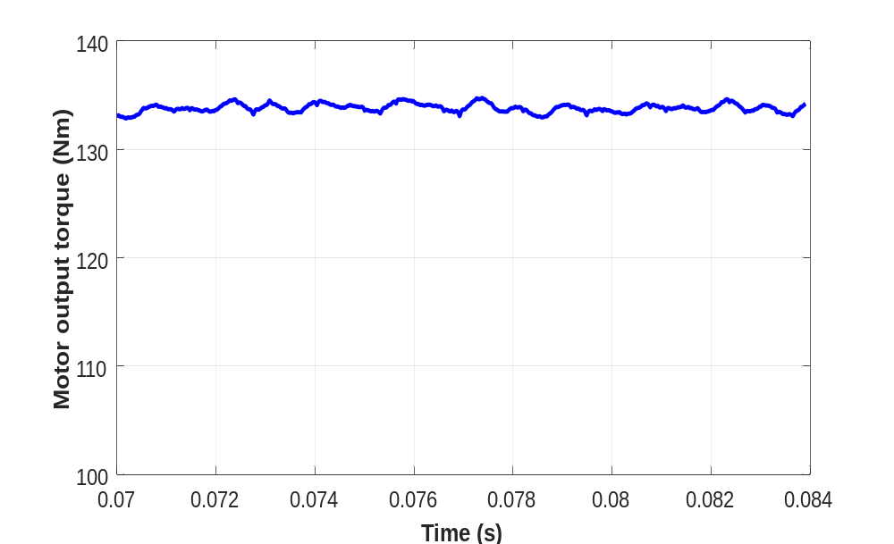
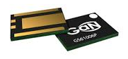
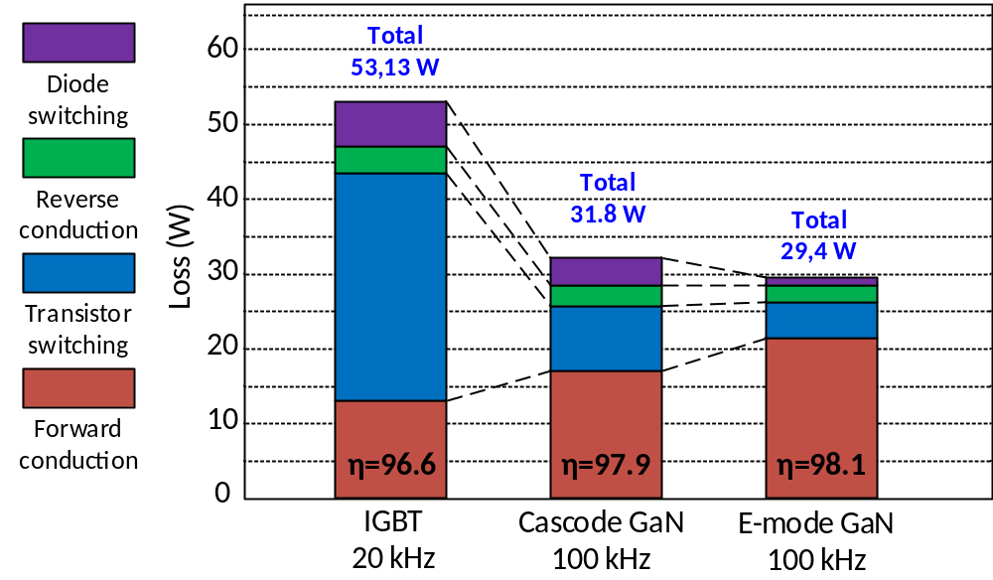
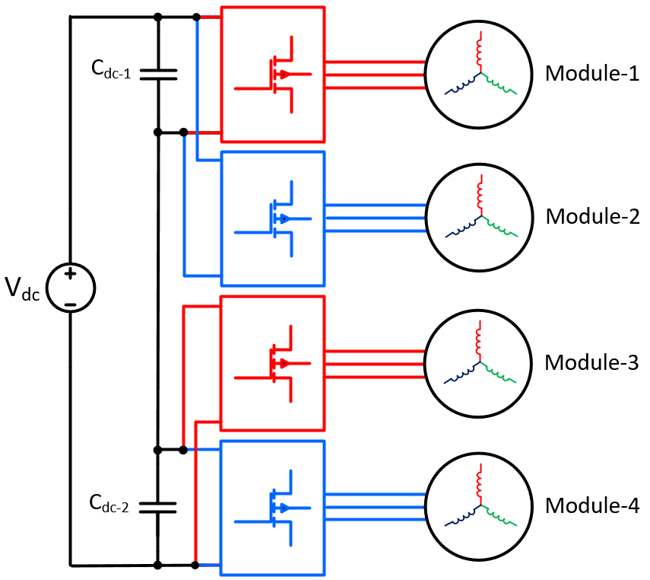
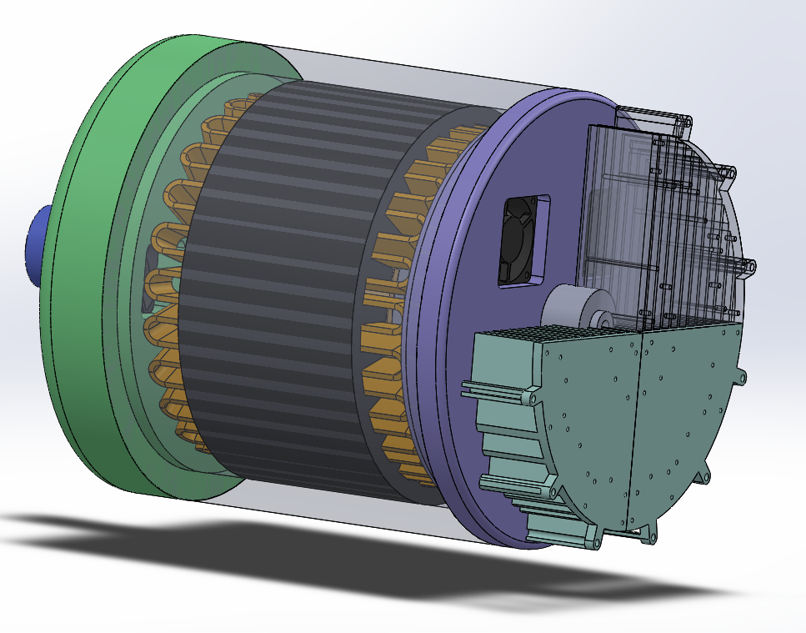
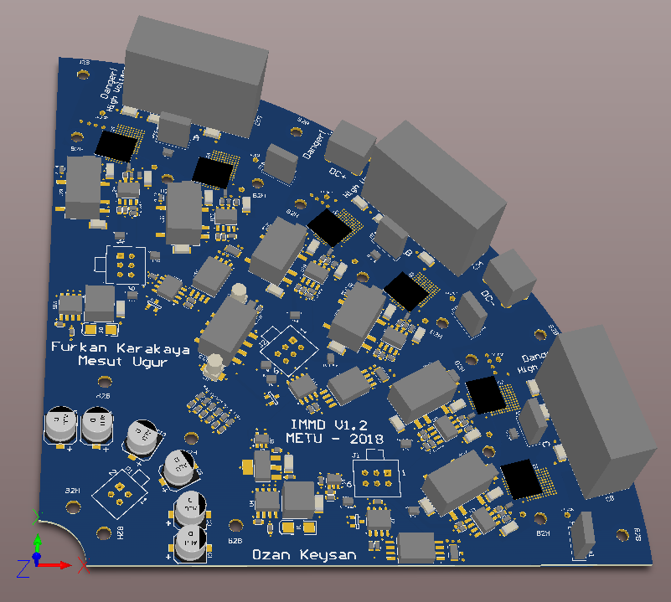
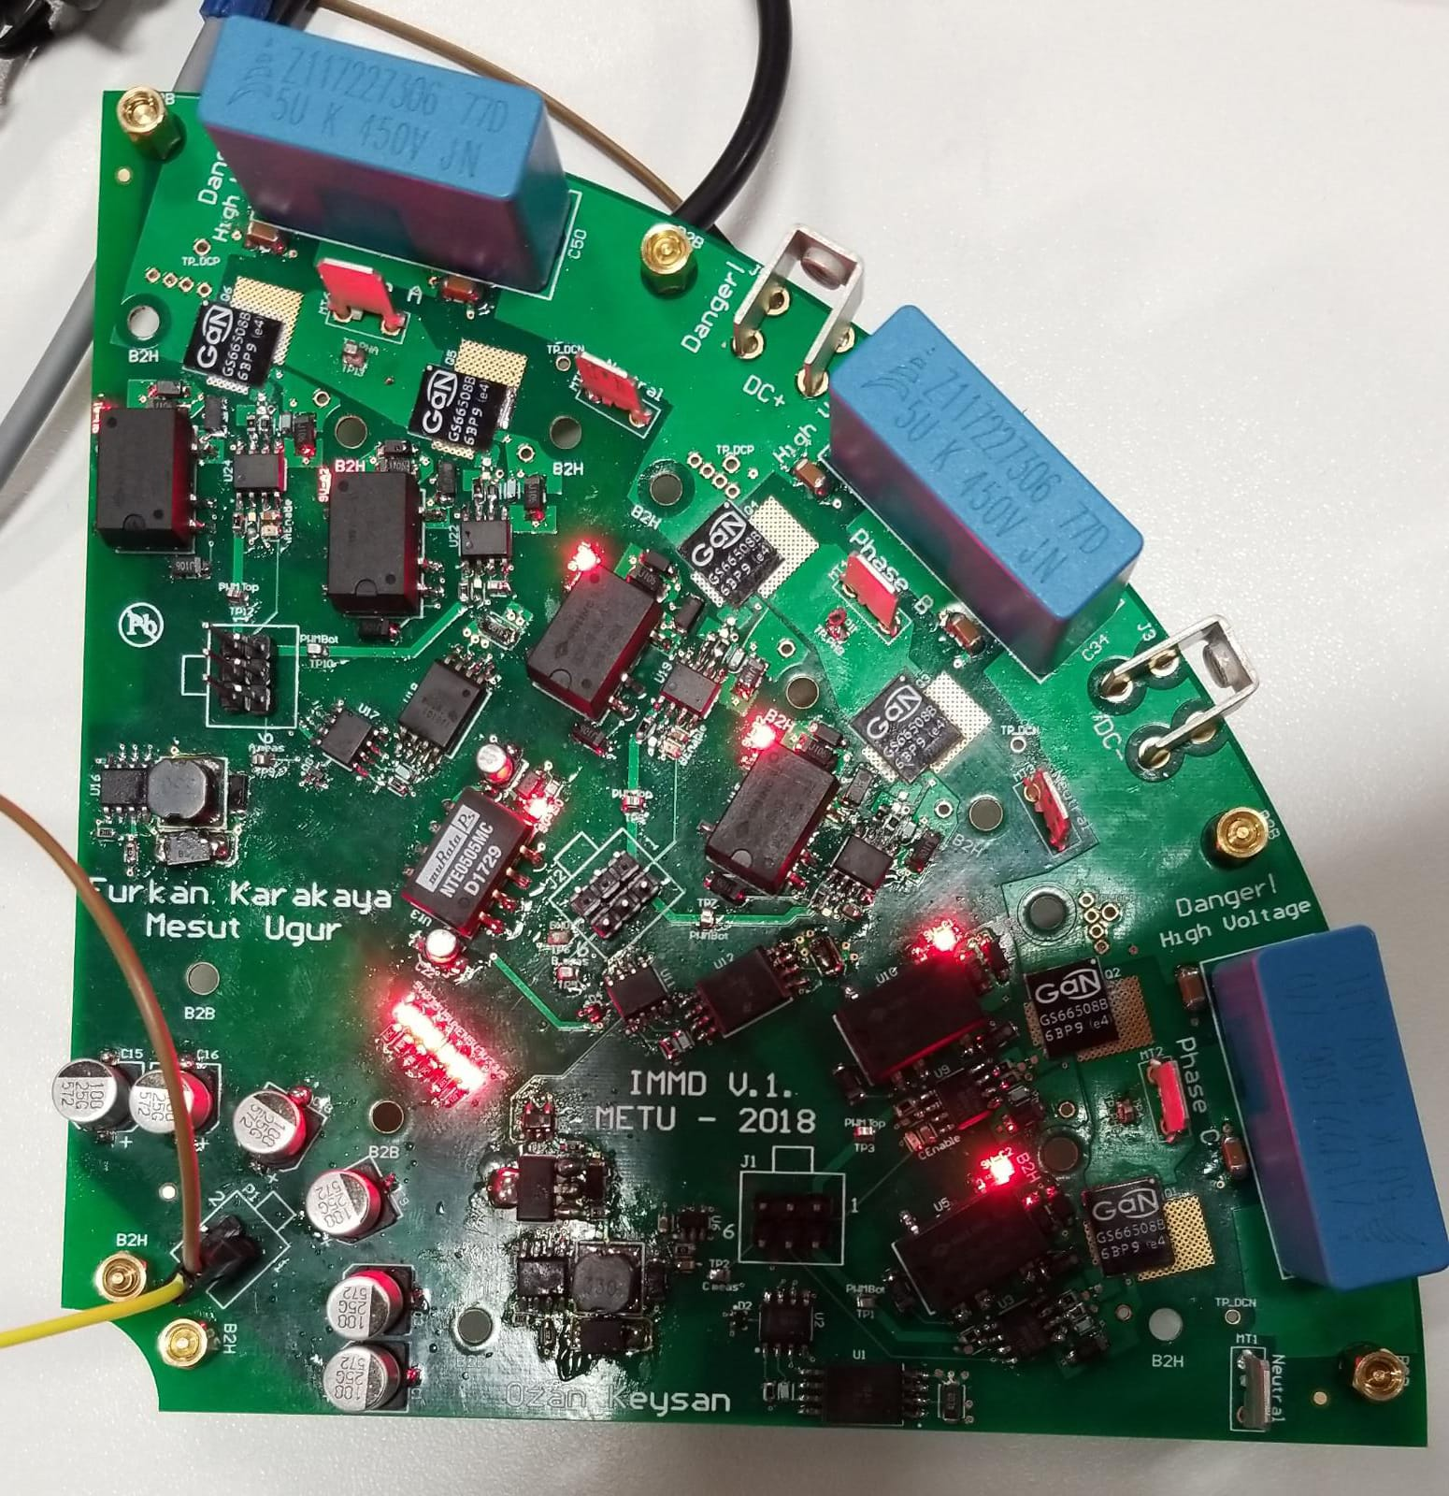
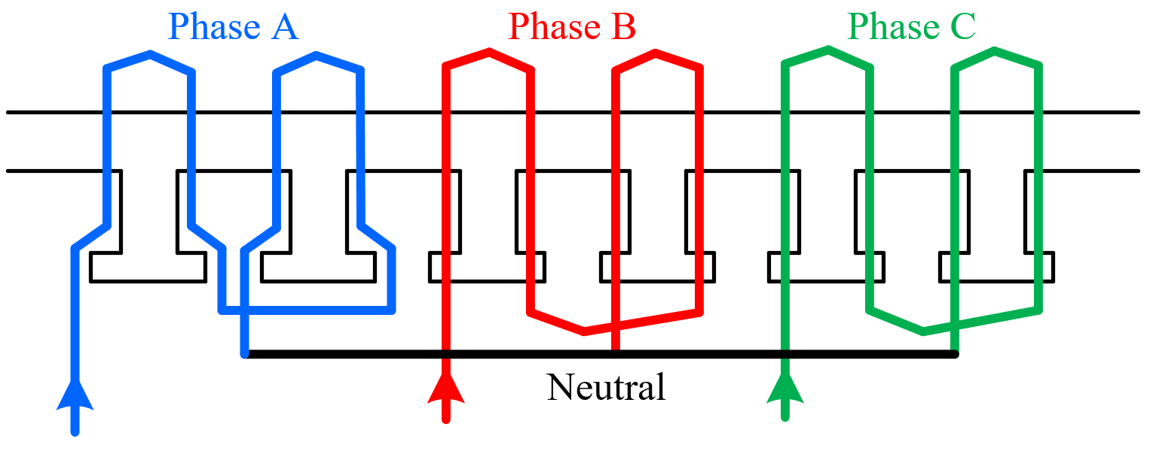
I C E M
XXΙIIrd International Conference on Electrical Machines (ICEM’2018)
Ramada Plaza Thraki
Alexandroupoli, GREECE
September 3-6, 2018
Paper Number AF-006871
Design of a GaN Based Integrated Modular Motor Drive
Mesut Uğur, Ozan Keysan
Middle East Technical University, Ankara, Turkey
mesut.ugur@metu.edu.tr, keysan@metu.edu.tr
Abstract - In this study, design procedure of an Integrated Modular Motor Drive (IMMD) is presented focusing on high power density. The design is based on a permanent magnet synchronous motor (PMSM) and GaN FETs. Fractional slot concentrated windings are used on the stator. Slot/pole combination and winding configuration is selected based on having low cogging torque and high winding factor. An extended motor drive inverter topology is proposed where 2-level voltage source inverters are connected both in series and parallel. Optimum selection of number of modules is discussed and power semiconductor devices are selected based on loss characterization. Optimum DC link capacitor bank is determined and the effect of interleaving is investigated. The performance of the motor is validated with ANSYS/Maxwell simulations. Motor drive performance is obtained with MATLAB/Simulink simulations. The efficiency of the motor drive is enhanced by 2% compared to a conventional motor drive. An overall system power density over 1 kW/lt has been achieved with the proposed series/parallel motor drive configuration having GaN FETs.
Introduction
Design Procedure
In conventional motor drive systems, drive units are placed in a separate cabinet, and they are connected to the motor via long cables.
In integrated modular motor drives (IMMD), the motor drive is integrated directly to the motor back-end and the system is modularized by dividing into several parts.
Slot/pole (24/20) is selected based on low cogging torque and high winding factor
Motor dimensions are designed by electric (A) and magnetic (B) loading
Voltage requirement is obtained and number of turns are calculated
Three different power semiconductor devices are selected for comparison
An analytical power semiconductor loss model is used for efficiency
A DC Link model for a modular converter is obtained and capacitance and RMS ripple current are calculated
Integration
Power density of the overall system is enhanced significantly.
Voltage overshoots due to cabling effect is eliminated [2].
Figure 1. IMMD Example [1]
Simulation Results
Modularization
Fault tolerance is increased [3].
Voltage stress on modules is reduced.
Heat dissipation is distributed to a wider area.
IMMD Structure
Challenges
Fitting into a small volume requires size reduction and optimum placement.
Cooling of both units should be achieved simultaneously.
Electronic components are subjected to high temperature and vibration [4].
Figure 6. Interleaving effect on DC Link voltage
Figure 8. Motor induced voltages (2D FEA)
Figure 10. Flux density distribution (2D FEA)
Figure 2. IMMD Structure [4]
Figure 9. Motor line currents (2D FEA)
Torque Ripple: 1.25%
Gallium Nitride (GaN) utilization
Low semiconductor loss: heat sink size is reduced
High operation frequency: passive component size is reduced
Figure 7. Interleaving effect on DC Link current
Figure 11. Motor torque (2D FEA)
Figure 3. GaN [5]
RMS of DC Link ripple current is reduced by half with interleaving
Capacitance requirement on the DC Link is reduced by half with interleaving
A 1 kW/lt power density is achieved with 50 kHz switching frequency with GAN
Torque ripple and cogging torque are reduced with optimum magnet shape design
Design of the IMMD System
IMMD Topology
Permanent Magnet Synchronous Motor
Output power: 8 kW
Rated speed: 600 rpm
DC Link voltage: 540 V
2-series connection is required due to voltage requirement of GaN
Number of parallel connected modules is decided based on interleaving effect
Figure 12. Loss comparison of devices
IMMD Prototype
Fractional Slot Concentrated Winding
Figure 4. IMMD topology with 2-series and 2-parallel connection
Figure 5. Winding diagram of one module
Figure 13. Aseembly of the motor
Figure 14. Drawing of one-modüle PCB
Figure 15. Picture of one-modüle PCB
Conclusions:
References:
A 8 kW IMMD is designed with Permanent Magnet Synchronous Motor
A novel topology is proposed with 2-series and 2-parallel connection
Interleaving is used to reduce the size of DC link capacitors
GaN FETs are utilized with high switching frequency
A complete design is achieved with 98% drive efficiency and 96% motor efficiency
A total of 1 kW/lt power density is achieved
A fault tolerant motor drive system is achieved with ½ redundancy
N. R. Brown, T. M. Jahns, and R. D. Lorenz, “Power Converter Design for an Integrated Modular Motor Drive,” Ind. Appl. Conf. 2007. 42nd IAS Annu. Meet. Conf. Rec. 2007 IEEE, pp. 1322–1328, 2007.
J. Wang, Y. Li, and Y. Han, “Integrated Modular Motor Drive Design With GaN Power FETs,” IEEE Trans. Ind. Appl., vol. 51, no. c, pp. 3198–3207, 2015.
J. J. Wolmarans, M. B. Gerber, H. Polinder, S. W. H. De Haan, J. A. Ferreira, and D. Clarenbach, “A 50kW integrated fault tolerant permanent magnet machine and motor drive,” PESC Rec. - IEEE Annu. Power Electron. Spec. Conf., pp. 345–351, 2008.
A. Shea and T. M. Jahns, “Hardware integration for an integrated modular motor drive including distributed control,” in 2014
GaN Systems, “GaN Systems E-mode GaN FETs.” [Online]. Available: http://www.gansystems.com/. [Accessed: 15-Jan-2018].
E. A. Jones, F. F. Wang, and D. Costinett, “Review of Commercial GaN Power Devices and GaN-Based Converter Design Challenges,” IEEE J. Emerg. Sel. Top. Power Electron., vol. 4, no. 3, pp. 707–719, 2016.

